Slide 1
Write Your First Chaincode
Yinsheng Zhou

Slide 2
Answer the Questions
What is chaincode?
How do I implement chaincode?
What dependencies exist?
What are the major functions?
How do I pass different values to my arguments?
How do I securely enroll a user on my network?
How do I interact with my chaincode through the REST API?
How do I compile my chaincode? (optional)

Slide 3
Prerequisites
A Firefox or Chrome browser with access to www.bluemix.net
A Bluemix account
GitHub account and tools (from https://github.com/ )
GO Lang compiler installed (from https://golang.org/dl/) (optional)

Slide 4
Github Signup

Slide 5
Add SSH Access
How:
https://help.github.com/articles/generating-a-new-ssh-key-and-adding-it-to-the-ssh-agent/#platform-mac
ssh-keygen -t rsa -b 4096 -C “your_email@example.com”
Press “Enter” for all the questions follows
eval "$(ssh-agent -s)”
ssh-add –k ~/.ssh/id_rsa
Pbcopy < ~/.ssh/id_rsa.pub
cat ~/.ssh/id_rsa.pub (for windows users)

Slide 6
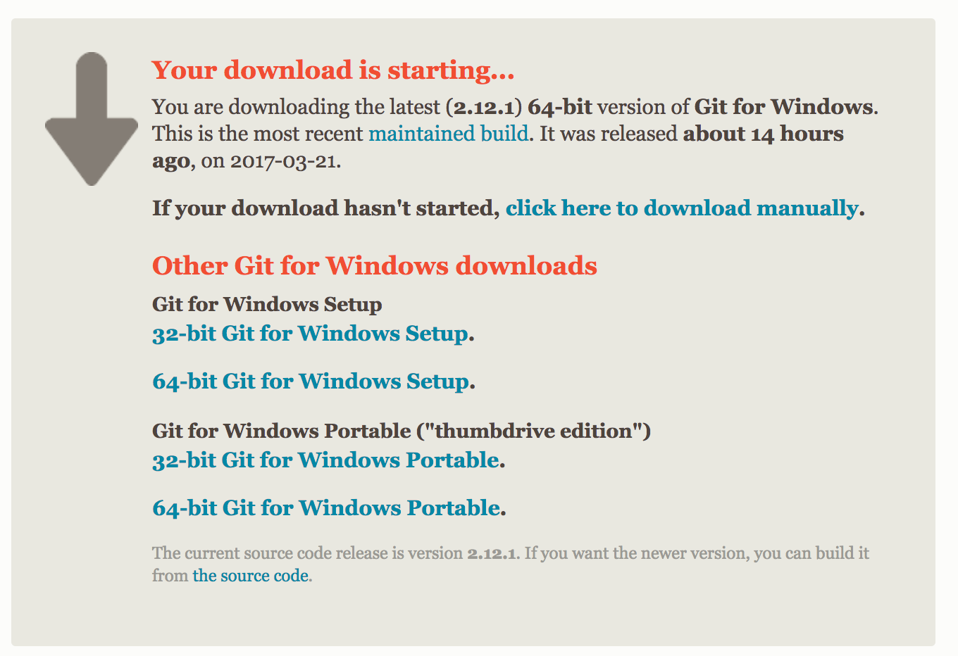
For Windows Users: Install Git Bash
https://git-scm.com/download/win

Slide 7
Add SSH Public Key into Github
2
1
5
3
4
6

Slide 8
Fork project
Fork to your own repository
https://github.com/IBM-Blockchain/example02
git clone git@github.com:easonzhou/example02.git
cd example02/chaincode
Take a look at the file - chaincode_example02.go

Slide 9
Enroll a user
{
"enrollId": "admin",
"enrollSecret": "3d2f404ebf"
}

Slide 10
Deploy and Init chaincode
{
"jsonrpc": "2.0",
"method": "deploy",
"params": {
"type": 1,
"chaincodeID": {
"path": "https://github.com/easonzhou/example02/chaincode"
},
"ctorMsg": {
"function": "init",
"args": [
"A", "100", "B", "200"
]
},
"secureContext": ”admin"
},
"id": 0
}
Replace it with your own github id

Slide 11
Query the account balance of user “A”
{
"jsonrpc": "2.0",
"method": "query",
"params": {
"type": 1,
"chaincodeID": {
"name": "17476a9d31a138b1f9c5414dd89bb729218d55ed901cd490e42131707df2015da6e7bf1a299433173589dcb5533cfb027f059bb247cb0db35a74428c515d5ee4"
},
"ctorMsg": {
"function": "query",
"args": [
"A"
]
},
"secureContext": "admin"
},
"id": 1
}
Replace it with your own chaincode id

Slide 12
Transfer 10 amount from “A” to “B”
{
"jsonrpc": "2.0",
"method": "invoke",
"params": {
"type": 1,
"chaincodeID": {
"name": "17476a9d31a138b1f9c5414dd89bb729218d55ed901cd490e42131707df2015da6e7bf1a299433173589dcb5533cfb027f059bb247cb0db35a74428c515d5ee4"
},
"ctorMsg": {
"function": "invoke",
"args": [
"A", "B", "10"
]
},
"secureContext": "admin"
},
"id": 2
}
Replace it with your own chaincode id

Slide 13
Query balance of user “B”
{
"jsonrpc": "2.0",
"method": "query",
"params": {
"type": 1,
"chaincodeID": {
"name": "17476a9d31a138b1f9c5414dd89bb729218d55ed901cd490e42131707df2015da6e7bf1a299433173589dcb5533cfb027f059bb247cb0db35a74428c515d5ee4"
},
"ctorMsg": {
"function": "query",
"args": [
"B"
]
},
"secureContext": "admin"
},
"id": 3
}
Replace it with your own chaincode id

Slide 14
Backup

Slide 15
Install Golang
https://golang.org/dl/#go1.6.3
Windows users:
Download go1.8.windows-amd64.msi
By default, it puts the Go distribution in c:\Go
The installer should put the c:\Go\bin directory in your PATH environment variable
You may need to restart any open command prompts for the change to take effect
Mac users:
Download go1.8.darwin-amd64.pkg
Installs the Go distribution to /usr/local/go
Should put the /usr/local/go/bin directory in your PATH environment variable

Slide 16
Git clone
$ mkdir –p $HOME/golang/
$ export GOPATH=$HOME/golang
# Create the parent directories on your GOPATH
mkdir -p $GOPATH/src/github.com/hyperledger
$ cd $GOPATH/src/github.com/hyperledger
# The v0.6 release exists as a branch inside the Gerrit fabric repository
git clone -b v0.6 http://gerrit.hyperledger.org/r/fabric

